Slide 1

Reports from Abroad:
Microsoft Ignite & Educause

Slide 2
Topics
Climate – Two Conferences, Common Ideas
Microsoft Ignite
Topic 1 – Customer Facing Stuff
Topic 2 – SCCM / Modern Device
Topic 3 – Azure & Azure Active Directory
Teams
Educause
A Little on Educause
The “Business” Climate
Environmental Positioning

Slide 3


Changes – Strategy
Leveraging
DEI – Front And Center

Slide 4

Erik’s Topic
Endpoint Manager
Intune/SCCM merging
Co-Management
On-prem cache
Peer cache
Branch Cache
Delivery Optimization

Slide 5
Russell’s Topic
Desktop Analytics
User Analytics
Edge

Slide 6

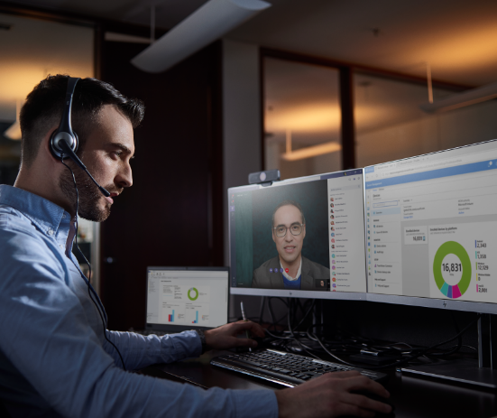

Desktop Analytics
To help you efficiently deploy and keep Windows 10 current
Your favorite Windows Analytics features
Deep Integration with Microsoft Management Tools
Single Pane of Glass for Windows Get and Stay Current
Full View into device inventory
Deployment Monitoring and Diagnosis
Data Driven Pilot Ring Creation
Pilot Success and Post Upgrade Health Insights
Make informed decisions
Simplify the deployment process
Notes:
Desktop Analytics is for moving between version of windows
Works off the telemetry - > diagnostic data
The better we provide, the better information we get
Windows Store has Diagnostic Data Viewer, if someone wants to review what information is being sent
The end goal being that, on the day of actual release, we can give a go/no go for a build upgrade vs waiting 2-3 months AFTER release day

Slide 7

Make informed decisions
Application compatibility assessment, diagnostics data and representative pilots, to help you generate actionable insights
Compatibility
analysis
Pilot recommendations
Data
insights
Installed applications
Analysis results
Typical pilots optimized around convenience
Desktop Analytics
Desktop Analytics pilot optimized
for an optimal mix
Notes:
Diagnostic data sent to Azure comes back to our tennant
Apps are scanned for known issues, returns Noteworthy Apps
Can label those apps for importance to our organization
Usual pilot groups are the best computers or friendly departments, not a true sample of the environment
Desktop Analytics generated groups will pull all of the different type of computers, applications, useage styles
Post Success and Post Upgrade Health Insights are retured to Desktop Analytics
We can provide a better report than "we didn't get any calls"

Slide 8
Improvements to App Confidence Engine
Framework Dependency (.NET, VC++, Silverlight)
Framework Dependency (.NET, VC++, Silverlight)
Risk Assessment with Possible Remediations
Java Dependency
Java Dependency
OS Version Violations
OS Version Violations
Analytics Data
Ready for Windows
+
MS Known Issues
➔
Analytics Data
Ready for Windows
+
MS Known Issues
Driver Dependency
VB6 Dependency
Driver Dependency
VB6 Dependency
UAC Violations
UAC Violations
UI Access
UI Access
Non-DPI awareness
Low
Medium
High
Non-DPI awareness
16-bit binaries
16-bit binaries
Notes:
Applications scanned by Desktop Analytics are checked for many factors before being presented in our console
Provides us with some risk

Slide 9
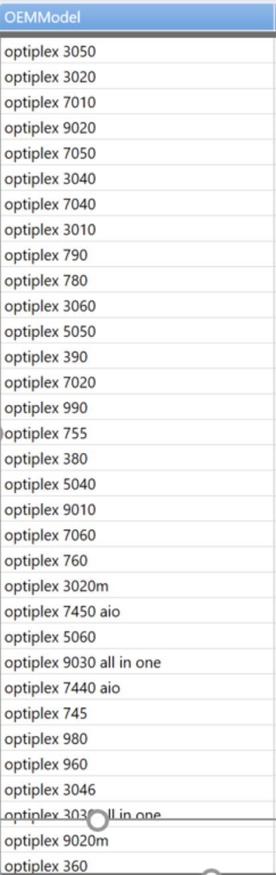
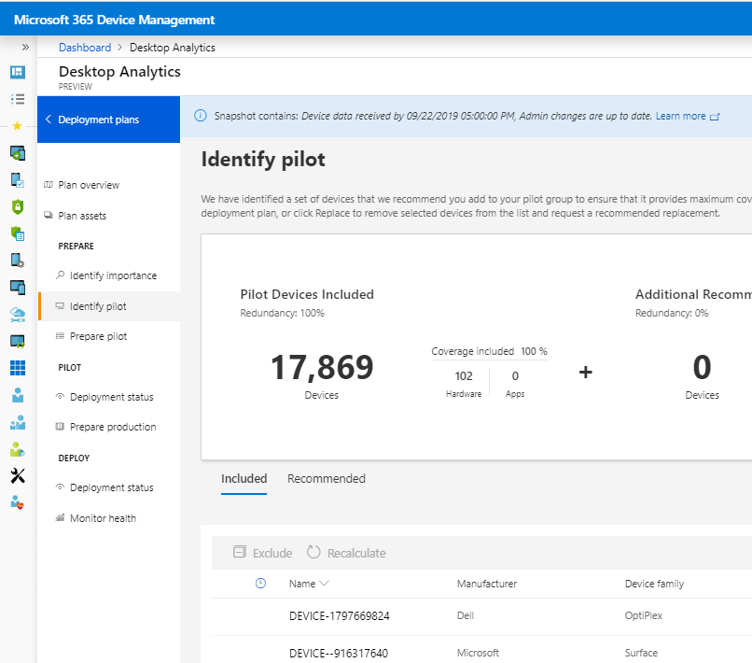
Better pilot representation
➔
Notes:
At time of generating the Pilot groups, we can identifiy what variables we want to target
It provides feedback on how much a selected Model or Application helps represent the environment and how much
It also suggests multiples for every variable, incase some system is off or if one works and one fails

Slide 10
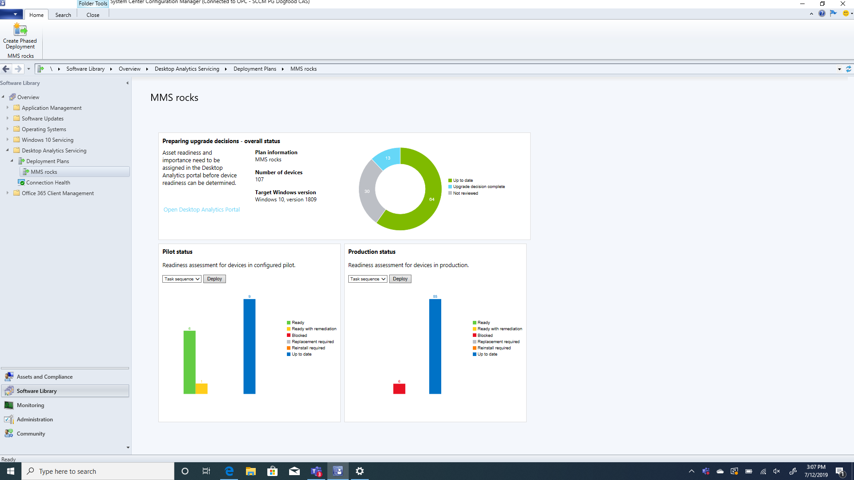
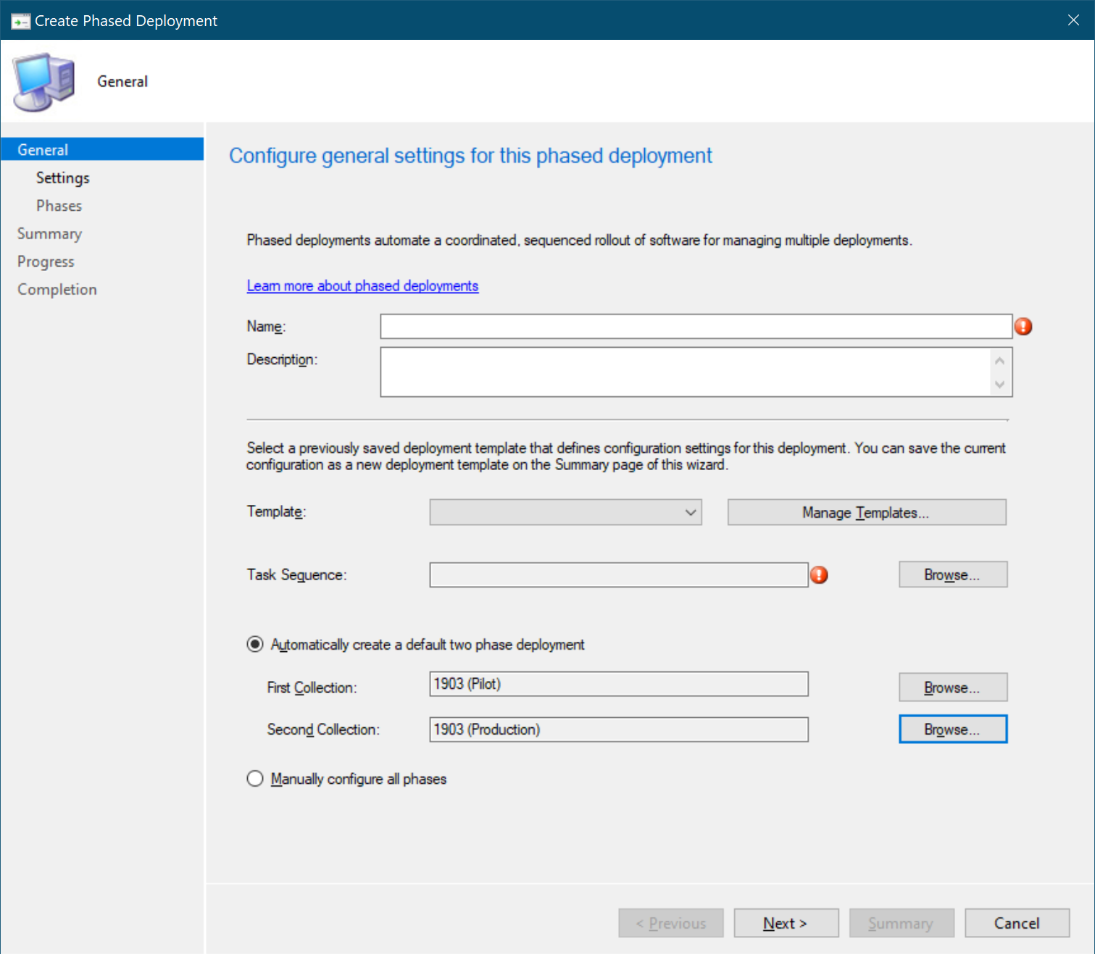
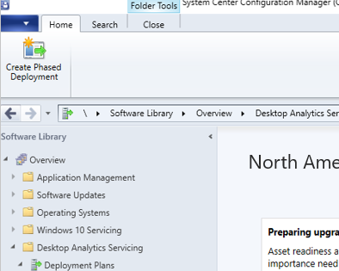
Integration with Phased deployments
Notes:
Those groups are available directly to Endpoint Manager Config Manager
We don't need to define them one place, then re-create them into the next

Slide 11
User Experience Analytics

Slide 12
Lack of visibility into the end-user experience
Most IT departments rely on support to identify end-user problems
End-user
Tier 1 support
Tier 2
Tier 3
Product group
most issues minutes to resolve hours to resolve days to resolve weeks/months to resolve
not reported
Slow
Expensive
Issues go unreported
End users have no clue

Slide 13



A better way…
Proactive insights of user experience integrated into endpoint management tools
Provide IT with an end-user experience “score” and recommendations
Monitor
Report
Perf
Reliability
User SAT
…
User experience score
Recommendations
Analytics and Remediation logic built into Microsoft Endpoint Management
Config changes
HW procurement standards changes
Pro-active remediation

Slide 14
Feature Overview
Recommended software
Experience score
Remediation scripting
Startup performance
*Available in the Microsoft Endpoint Management (aka Intune) portal for either Intune or ConfigMgr managed devices

Slide 15


Deployment
Configuration
Security Baselines
IE mode

Slide 16
Next steps
Deploy and configure the next version of Microsoft Edge using the tools of your choice
Try configuring IE mode for your organization
Sleep well knowing that your end users only have a single browser to use going forward ☺

Slide 17
Derrick’s Topics
Lightning Round
-Autopilot
-Planner (including Teams integration)
-Project Cortex
-Graph
-Teams & Canvas Integration
-Teams Rooms
-Learning Pathways (and Teams Integration)

Slide 18
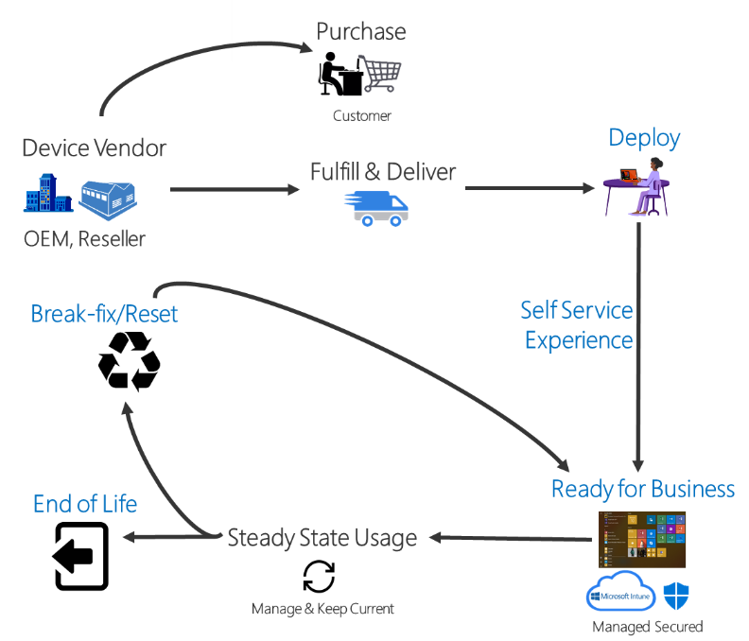

Slide 19
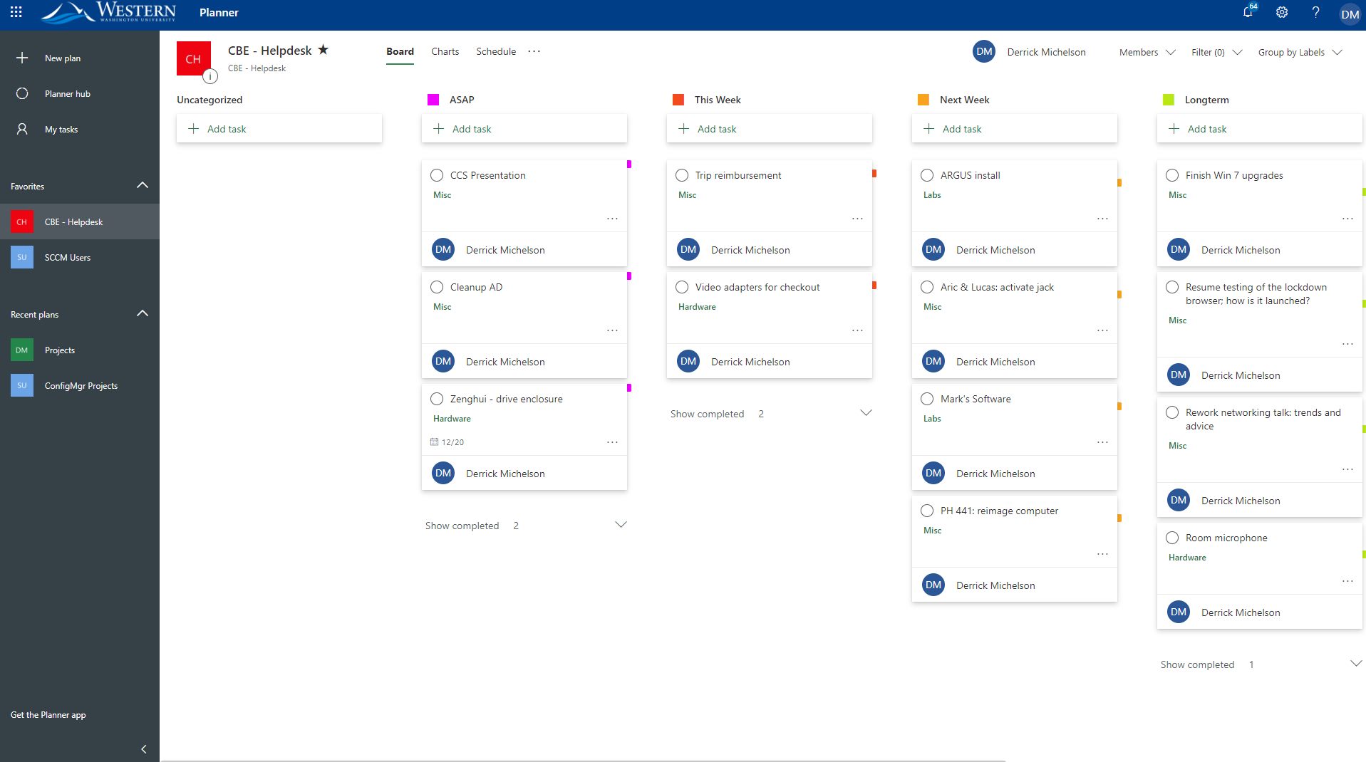

Slide 20
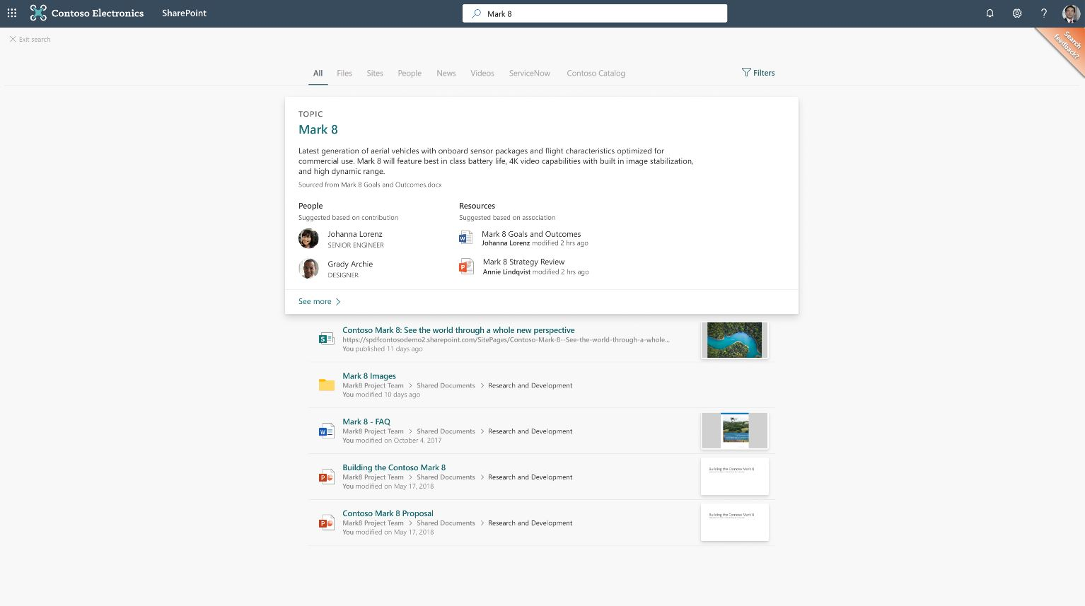

Slide 21
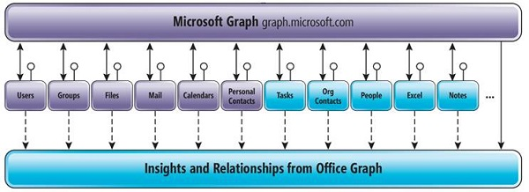

Slide 22
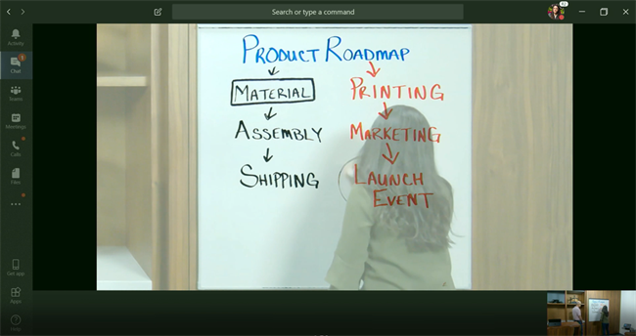

Slide 23
Jon’s Topic
Active Directory & Azure AD
DEI – Front And Center
Building Champions & Communities
Notes:
Big Surprise -
Teams!
Azure!
DEI?
Champions?

Slide 24












Azure AD · User provisioning for apps
Azure AD
Cloud HR
On-premises & web apps with pre-built connectors
Active Directory
Notes:
First Up Azure
Here is a quick overview of Microsoft's plans for Azure Active Directory
Currently, Azure AD is connected "downstream" of Active Directory
The model that Microsoft is pushing is a cloud centric hub for Identity.
AzureAD becomes connected to your HR system, which feeds ID into AzureAD, and from there that Identity is pushed down to AD on Premise, and throug SCIM provisioned to individual applications
SCIM? It is an API standard for Identity management, meaning that it’s a standard and the deployment of disparate apps could be managed in a standardized way.
SCIM and SAML work together, SCIM replaces the flat file transfer to a 3rd party, not the method for authentication which is still SAML

Slide 25

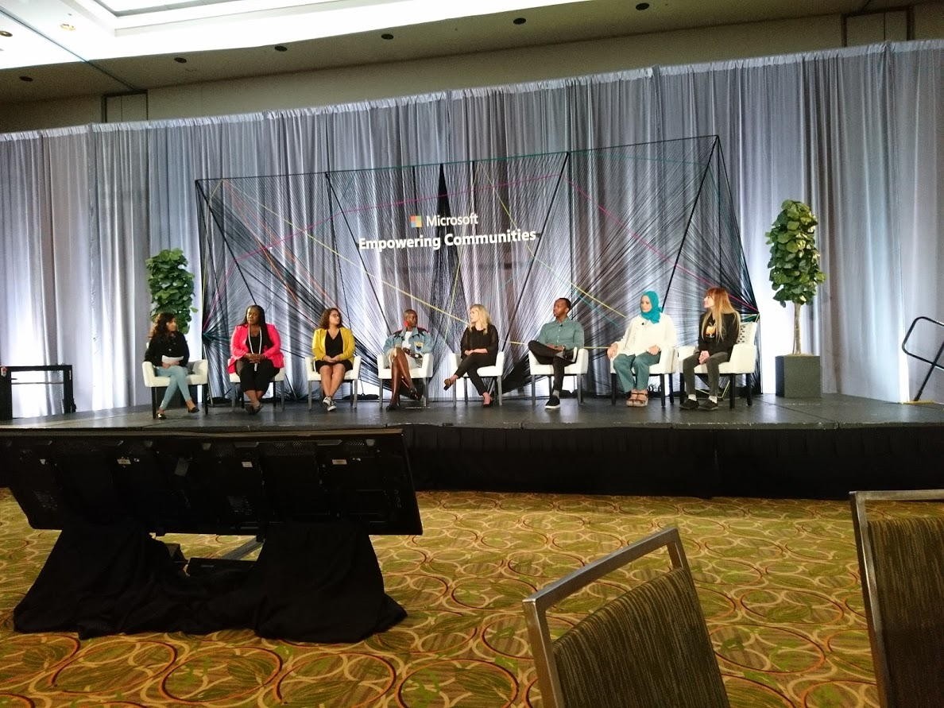

DEI – #HumansOfIT
Notes:
The first picture, I would point out was in the schwag pickup, 30,000 people had the opportunity to identitfy and share, and most took Microsoft up on the offer
My point is that Microsoft is putting DEI front and center. Throughout Ignite there were sessions specifically designed to address issues of Diversity, Equity & Inclusion
Personally, I think it’s the correct idea, especially contrasted with competators and higher education's own challenges with Place and adapting to a changed environment
I would encourage you to look at the Tribute Application and the #HumansOfIT
I'd be happy to share some contacts after CCS
Micro-Conference within Ignite

Slide 26
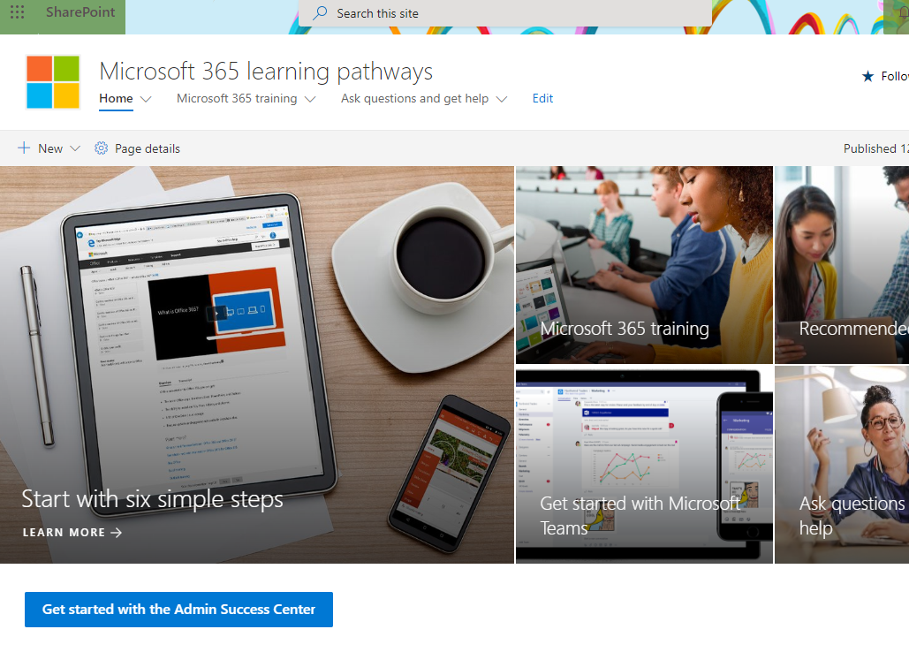
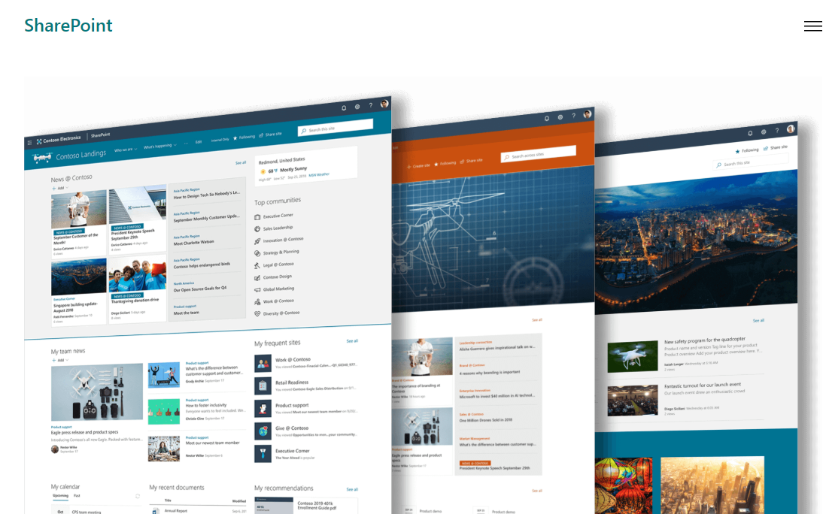
Building Champions
Notes:
Wouldn't it be great if we had more IT Pro's?
How can we encourage and drive adoption without cloning ourselves?
We Invite!
Microsoft released new SharePoint sites (not just templates) that will allow us to tweak and customized course content for Microsoft Applications, like Teams, Office and OneDrive
All of this is inside our Tenant
LearningPathways – Access and Invite after CCS
Demo Time

